Slide 1
Satisfiability Modulo Theories
Nikolaj Bjørner
Microsoft Research
Marktoberdorf Summer School
August 10 - 2015

Slide 2
Lectures
Mon: An Introduction to SMT with Z3
Wed: Algorithmic underpinnings of SAT/SMT
Thu: Theories, Solvers and Applications
Fri: Topics: Horn Clauses, Quantifiers, Optimization

Slide 3
Plan
Satisfiability Modulo Theories in a nutshell
SMT solving in a nutshell
SMT by example

Slide 4
Takeaways:
Modern SMT solvers are a often good fit for program analysis tools.
Handle domains found in programs directly.
The selected examples are intended to show instances where sub-tasks are reduced to SMT/Z3.

Slide 5

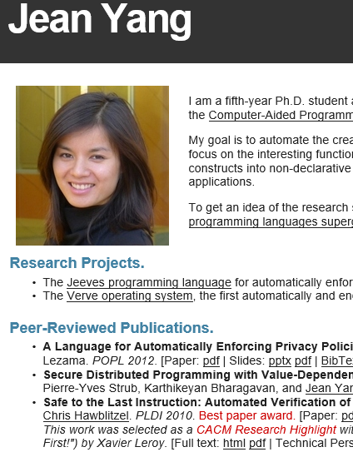

If you use Z3,
This could be you

Slide 6

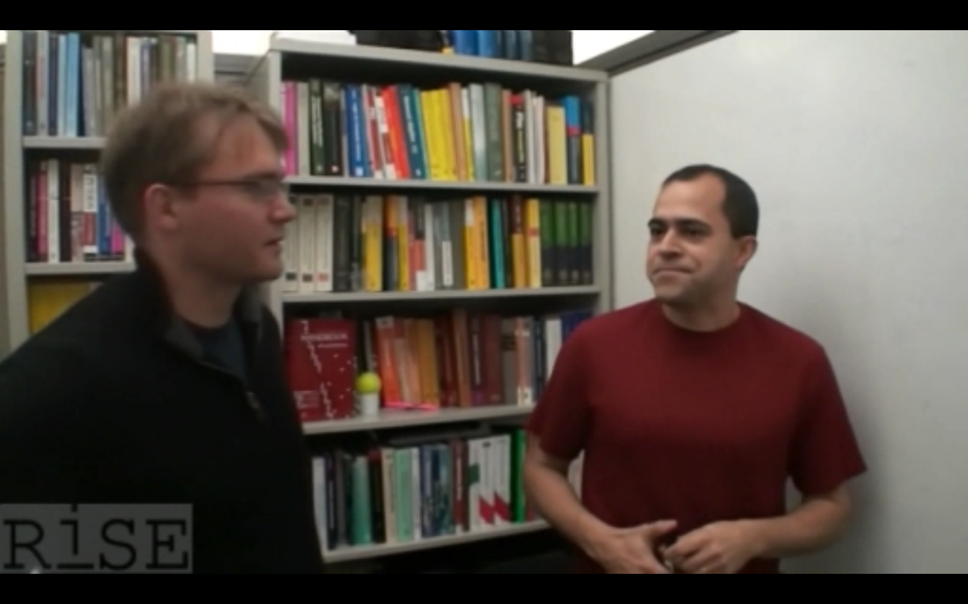

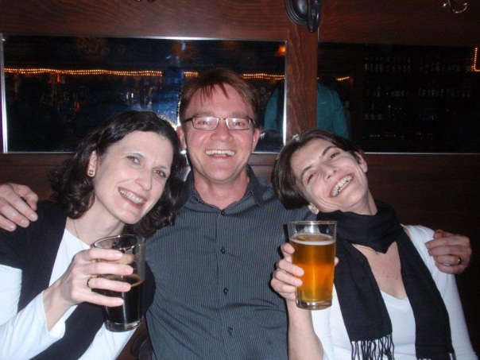
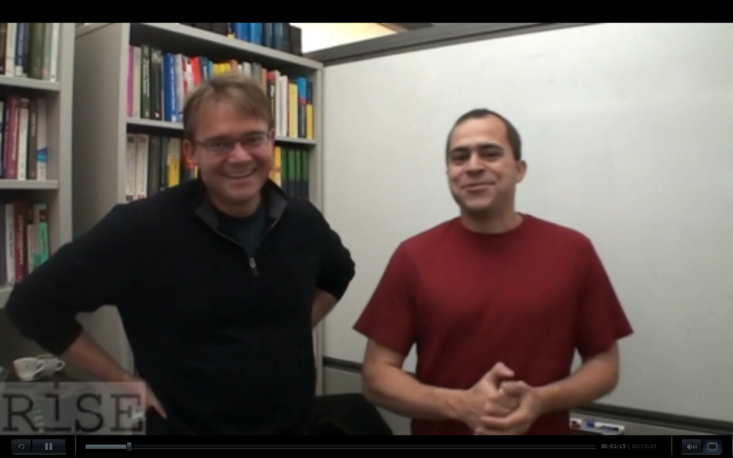

– Backed by Proof Plumbers
Handbook of Satisfiability
Not all is hopeless
Leonardo de Moura, Nikolaj Bjørner, Christoph Wintersteiger

Slide 7
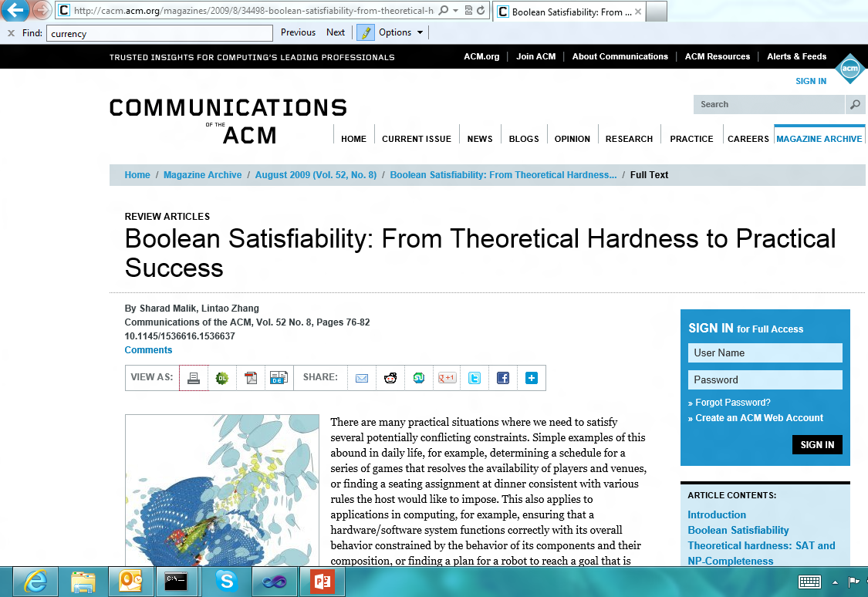
Background Reading: SAT

Slide 8
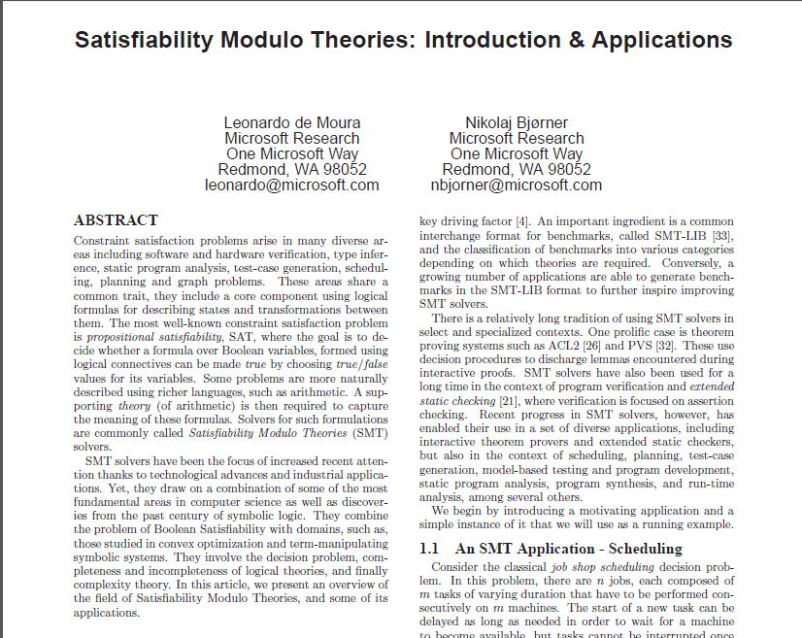

Background Reading: SMT
September 2011

Slide 9
Background Reading
Tractability and Modern Satisﬁability Modulo Theories Solver Bjørner and de Moura, Handbook of Tractability 2013.
Applications of SMT solvers Bjørner and de Moura, Notes 2013.
Horn Clause Solvers for Program Veriﬁcation Bjørner, Gurﬁnkel, McMillan, Rybalchenko YuriFest 2015.

Slide 10
SAT in a nutshell

Slide 11
SAT in a nutshell
(Tie ∨ Shirt) ∧ ( ¬Tie ∨ ¬Shirt) ∧ (¬Tie ∨ Shirt)

Slide 12
SMT in a nutshell

Slide 13
Satisfiability Modulo Theories (SMT)
Is formula ϕ satisfiable modulo theory T ?
SMT solvers have specialized algorithms for T

Slide 14
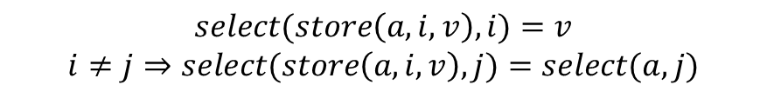
Satisfiability Modulo Theories (SMT)
$$x+2=y⇒f\left(select\left(store\left(a,x,3\right),y−2\right)\right)=f(y−x+1)$$
Array Theory
Arithmetic
Uninterpreted Functions
$$select(store\left(a,i,v\right),i)=v$$
$$i≠j⇒select(store\left(a,i,v\right),j)=select(a,j)$$

Slide 15
SMT Solving in a nutshell
Job Shop Scheduling

Slide 16






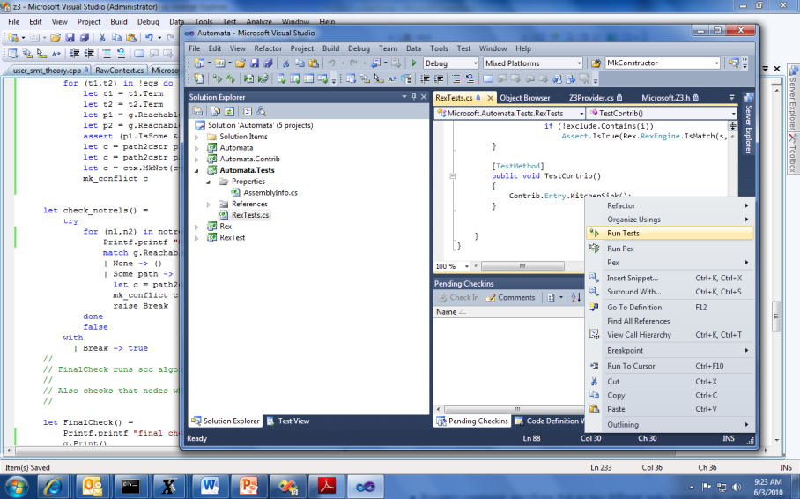


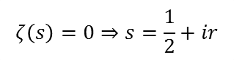
Job Shop Scheduling
Machines
Tasks
Jobs
P = NP?
Laundry
$$ζ\left(s\right)=0⇒s=\frac{1}{2}+ir$$

Slide 17

Job Shop Scheduling
Constraints:
Precedence: between two tasks of the same job
Resource: Machines execute at most one job at a time
3
1
2
4
$$\left[start_{2,2}..end_{2,2}\right]∩\left[start_{4,2}..end_{4,2}\right]=∅$$

Slide 18
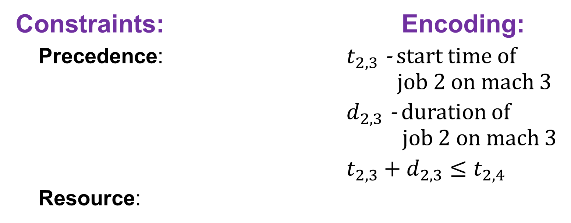
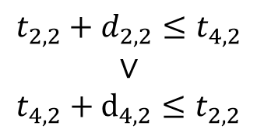
Job Shop Scheduling
Constraints: Encoding:
Precedence: $t_{2,3}$ - start time of job 2 on mach 3
$d_{2,3}$ - duration of job 2 on mach 3
$t_{2,3}+d_{2,3}≤t_{2,4}$
Resource:
3
1
4
2
Not convex
$$t_{2,2}+d_{2,2}≤t_{4,2}$$
$$∨$$
$$t_{4,2}+d_{4,2}≤t_{2,2}$$
$$\left[start_{2,2}..end_{2,2}\right]∩\left[start_{4,2}..end_{4,2}\right]=∅$$

Slide 19
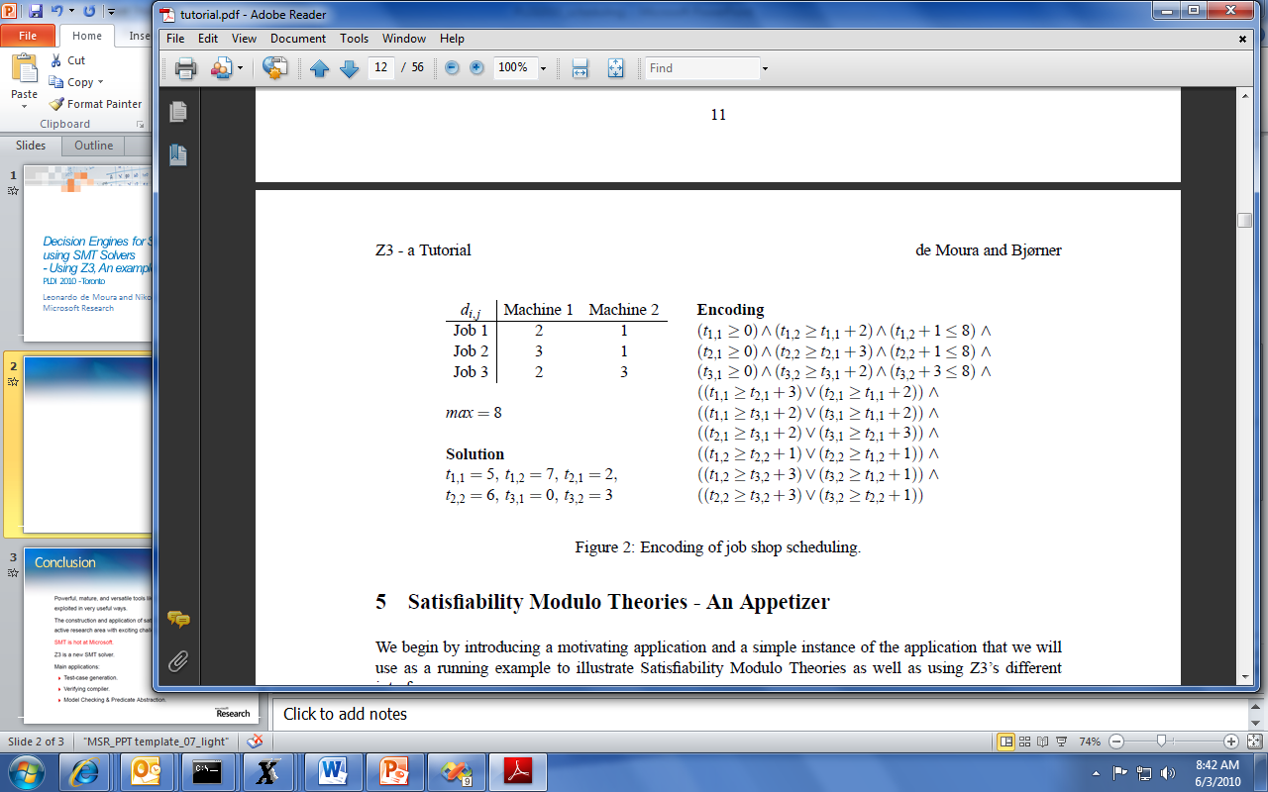
Job Shop Scheduling

Slide 20
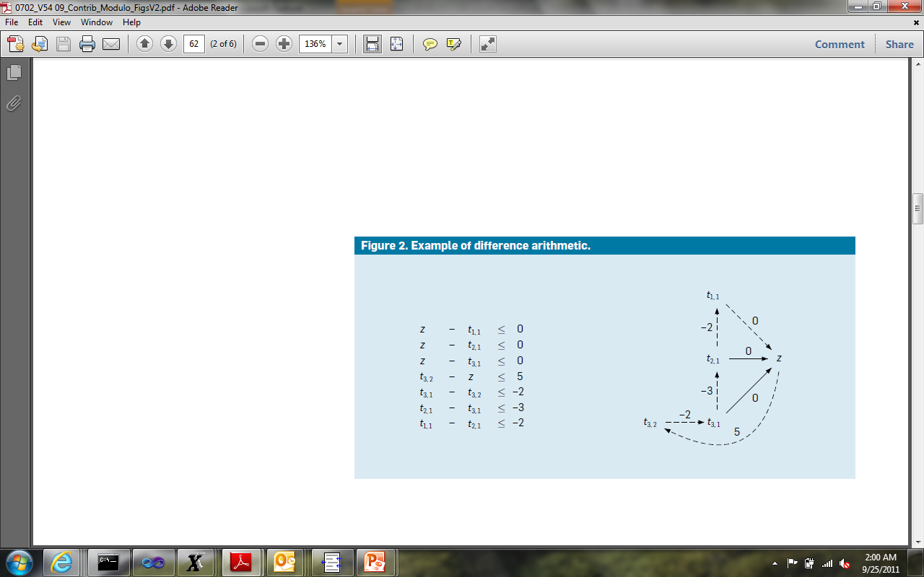
Job Shop Scheduling
Efficient solvers:
- Floyd-Warshal algorithm
- Ford-Fulkerson algorithm
case split
case split
$$z −z= 5 – 2 – 3 – 2 = −2 < 0$$

Slide 21
Theories

Slide 22
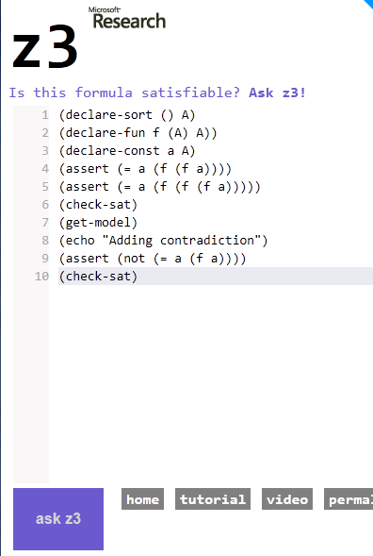
Theories
Uninterpreted functions

Slide 23
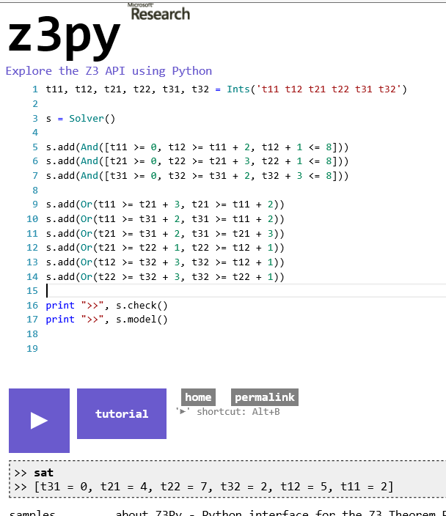
Theories
Uninterpreted functions
Arithmetic (linear)

Slide 24
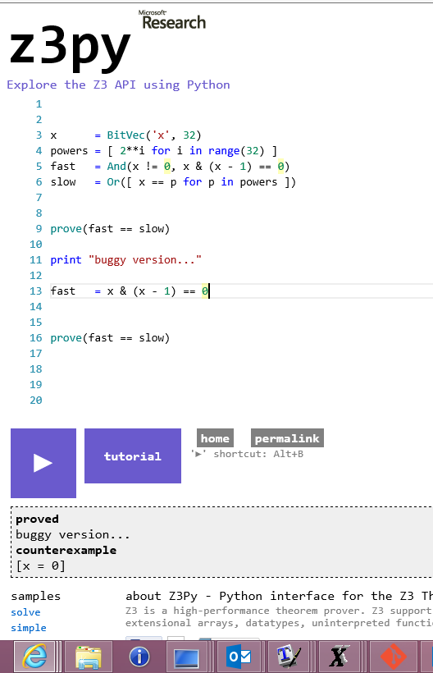
Theories
Uninterpreted functions
Arithmetic (linear)
Bit-vectors

Slide 25
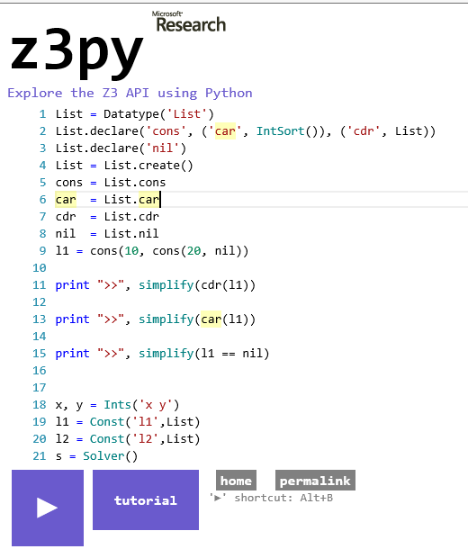
Theories
Uninterpreted functions
Arithmetic (linear)
Bit-vectors
Algebraic data-types

Slide 26
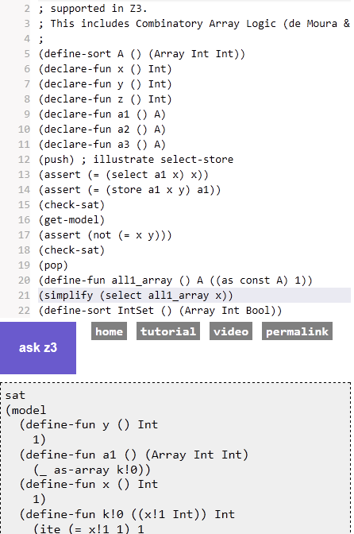
Theories
Uninterpreted functions
Arithmetic (linear)
Bit-vectors
Algebraic data-types
Arrays

Slide 27
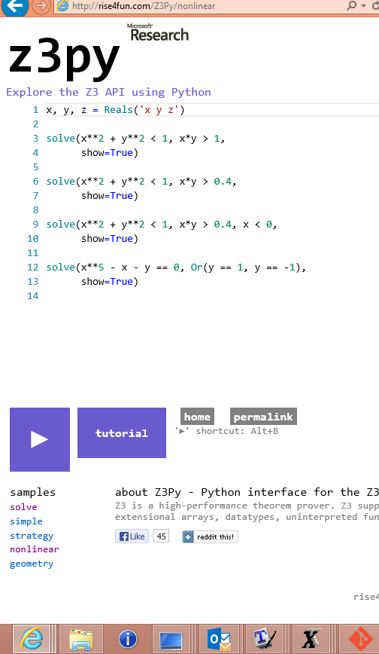
Theories
Uninterpreted functions
Arithmetic (linear)
Bit-vectors
Algebraic data-types
Arrays
Polynomial Arithmetic

Slide 28
QUANTIFIERS

Slide 29
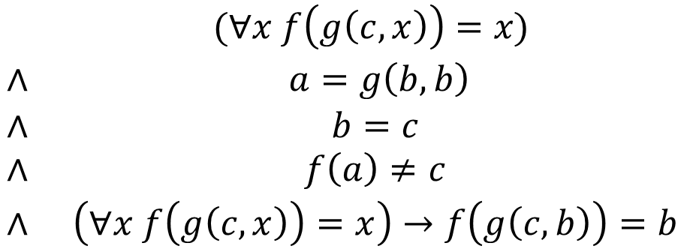
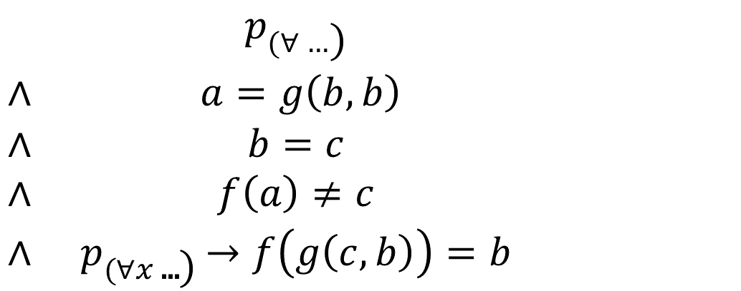
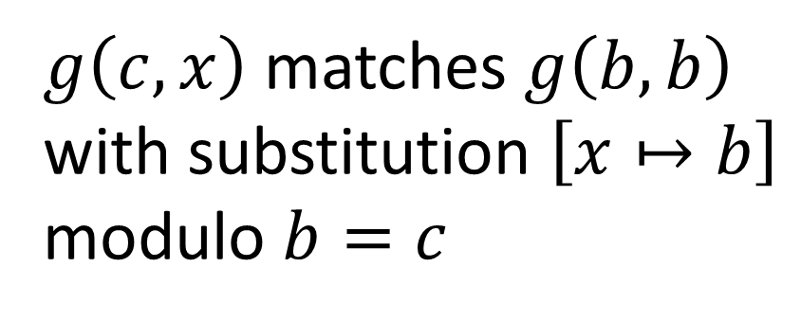
Equality-Matching
$\begin{matrix} & p_{(∀…\text{)}} \\ ∧ & a=g\left(b,b\right) \\ ∧ & b=c \\ ∧ & f\left(a\right)≠c \\ ∧ & p_{(∀x\text{ ...}\text{)}}→f\left(g\left(c,b\right)\right)=b\end{matrix}$
$$\begin{matrix} & (∀x f\left(g\left(c,x\right)\right)=x\text{)} \\ ∧ & a=g\left(b,b\right) \\ ∧ & b=c \\ ∧ & f\left(a\right)≠c \\ ∧ & \left(∀x f\left(g\left(c,x\right)\right)=x\right)→f\left(g\left(c,b\right)\right)=b\end{matrix}$$
$g\left(c,x\right)$ matches $g\left(b,b\right)$ with substitution $\left[x↦b\right]$ modulo $b=c$
[de Moura, B. CADE 2007]

Slide 30
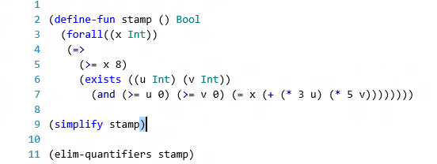
Quantifier Elimination
Presburger Arithmetic, Algebraic Data-types,
Quadratic polynomials
SMT integration to prune branches
[B. IJCAR 2010]

Slide 31
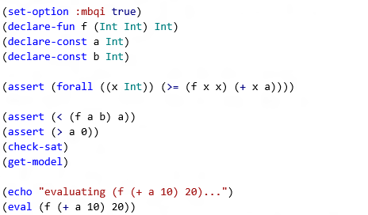
MBQI: Model based Quantifier Instantiation
[de Moura, Ge. CAV 2008]
[Bonachnia, Lynch, de Moura CADE 2009]
[de Moura, B. IJCAR 2010]

Slide 32
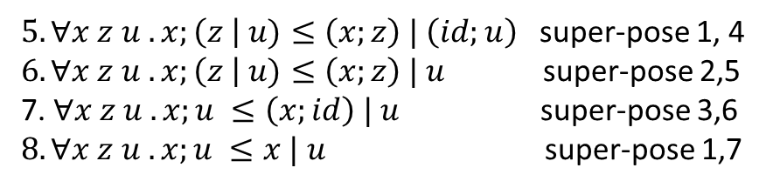
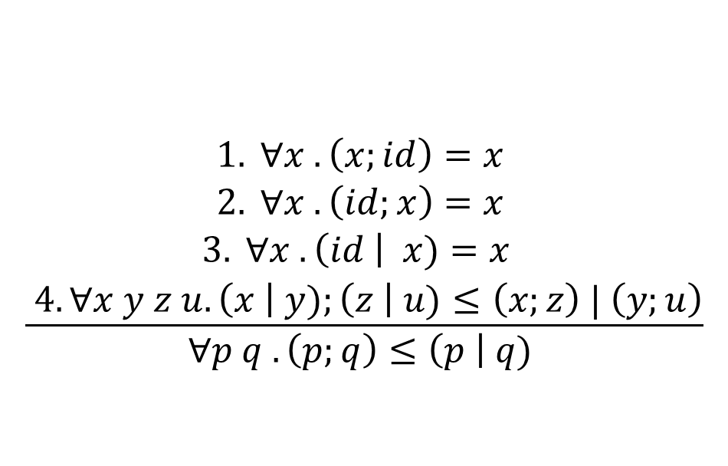
Superposition
$$\frac{\begin{aligned}1. ∀x . \left(x;id\right)=x \\ 2. ∀x . \left(id;x\right)=x \\ 3. ∀x . \left(id \right| x)=x \\ 4. ∀x y z u.\left(x \right| y);\left(z \right| u)≤\left(x;z\right) | \left(y;u\right)\end{aligned}}{∀p q .\left(p;q\right)≤\left(p \right| q) }$$
$5. ∀x z u .x;\left(z \right| u)≤\left(x;z\right) | \left(id;u\right)$ super-pose 1, 4
$6. ∀x z u .x;\left(z \right| u)≤\left(x;z\right) | u$ super-pose 2,5
7. $∀x z u .x;u ≤\left(x;id\right) | u$ super-pose 3,6
$8. ∀x z u .x;u ≤x | u$ super-pose 1,7
[de Moura, B. IJCAR 2008]
(disabled in release 4.1)

Slide 33
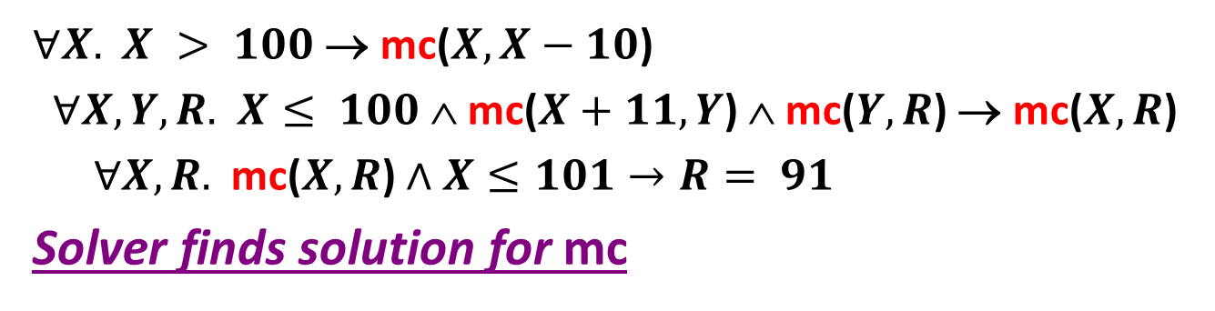
Horn Clauses
mc(x) = x-10 if x > 100
mc(x) = mc(mc(x+11)) if x ≤ 100
assert (mc(x) ≥ 91)
$∀X.$ $X > 100$→ mc($X,X−10$)
$∀X,Y,R.$ $X≤ 100$∧ mc($X+11,Y$) ∧ mc($Y,R$) → mc($X,R$)
$∀X,R.$ mc($X,R$) $∧X≤101→R= 91$
Solver finds solution for mc
[Hoder, B. SAT 2012]

Slide 34
MODELS, Proofs, Cores & Simplification

Slide 35
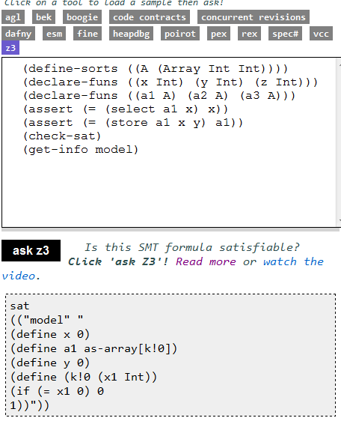
Models
Logical Formula
Sat/Model

Slide 36
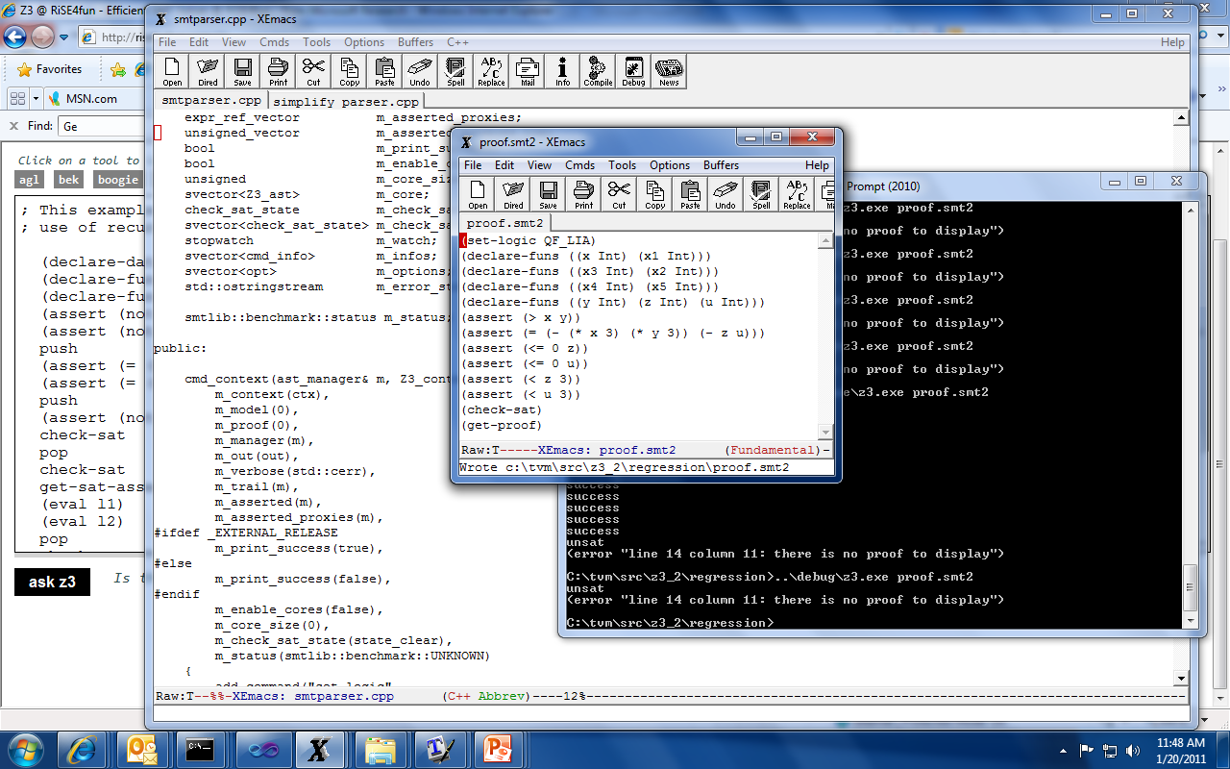
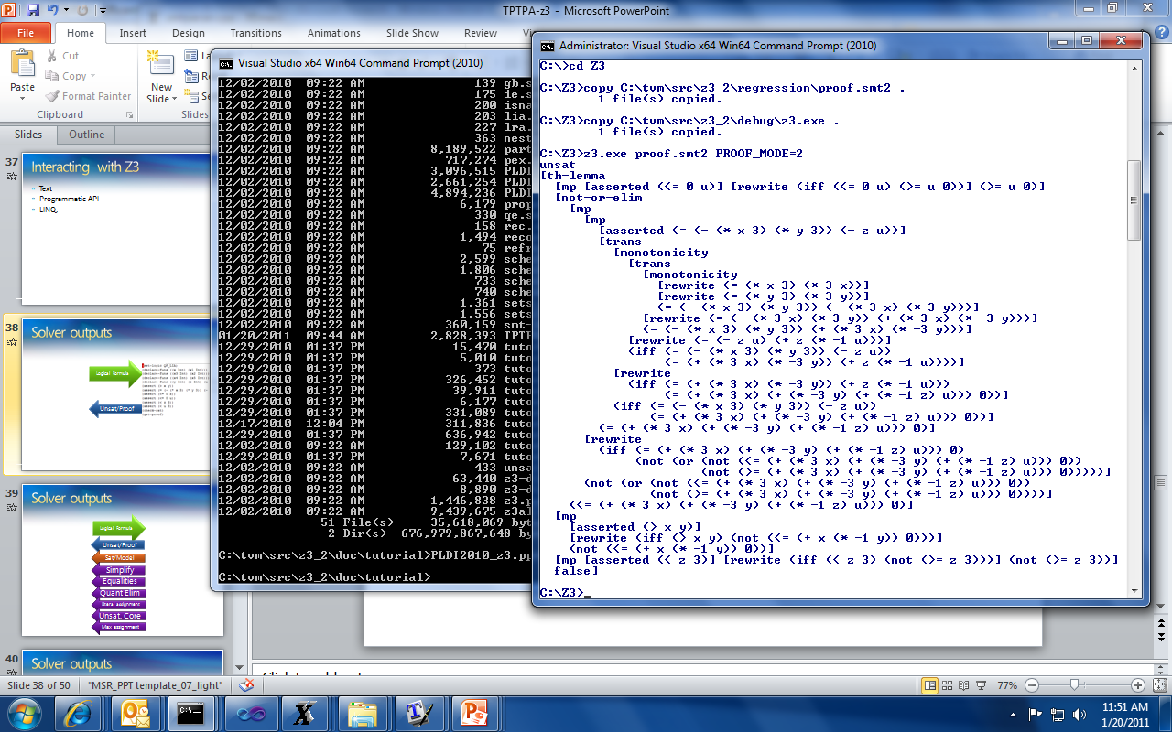
Proofs
Logical Formula
Unsat/Proof

Slide 37
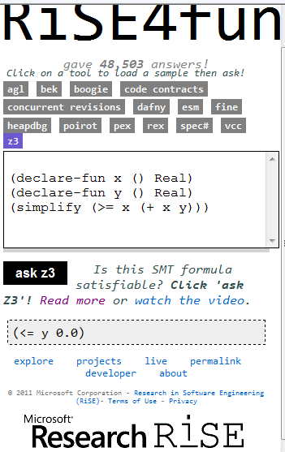
Simplification
Logical Formula
Simplify

Slide 38
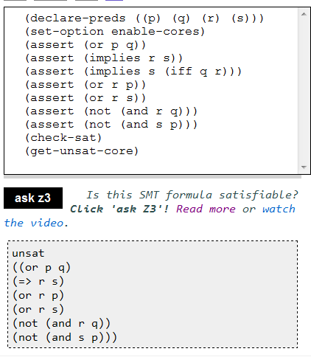
Cores
Logical Formula
Unsat. Core

Slide 39
TACTICS, SOLVERS

Slide 40
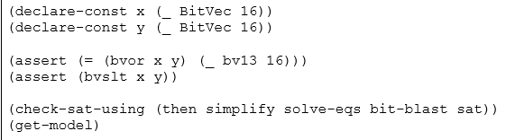
Tactics
Composition of tactics:
(then t s)
(par-then t s) applies t to the input goal and s to every subgoal produced by t in parallel.
(or-else t s)
(par-or t s) applies t and s in parallel until one of them succeed.
(repeat t)
(repeat t n)
(try-for t ms)
(using-params t params) Apply the given tactic using the given parameters.

Slide 41
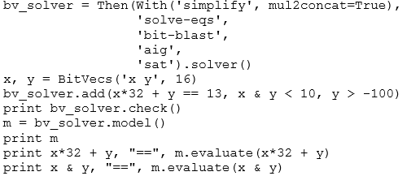
Solvers
Tactics take goals and reduce to sub-goals
Solvers take tactics and serve as logical contexts.
push
add
check
model, core, proof
pop

Slide 42
APIs
C++
python
OCaml
Java
.NET
C

Slide 43
Summary
Z3 supports several theories
Using a default combination
Providing custom tactics for special combinations
Z3 is more than sat/unsat
Models, proofs, unsat cores,
simplification, quantifier elimination are tactics
Prototype with python/smt-lib2
Implement using smt-lib2/programmatic API

